Slide 1
Harshavardhini A S
Final Project
3/21/2024 Annual Review

Slide 2
PROJECT TITLE
Stroke Prediction
3/21/2024 Annual Review

Slide 3


AGENDA
Problem Statement
Project Overview
Who are the end users?
Solutions and value of propositions
WOW factor in the solution
Modelling
Results
3/21/2024 Annual Review

Slide 4

PROBLEM STATEMENT
The aim of this project is to develop a predictive model using Long Short-Term Memory (LSTM) neural networks to identify individuals at risk of experiencing a stroke based on their demographic and health-related attributes. Stroke is a critical medical condition that requires timely intervention to prevent severe consequences. Early identification of individuals susceptible to stroke can facilitate proactive healthcare interventions and improve patient outcomes.
The dataset used for model development contains various attributes such as age, hypertension status, heart disease status, average glucose level, and body mass index (BMI) of individuals, along with a binary indicator of whether they have experienced a stroke or not.
3/21/2024 Annual Review

Slide 5

PROJECT OVERVIEW
Objective: Develop a predictive model using demographic and health-related attributes to accurately classify individuals into stroke or non-stroke categories.
Classification Task: The model will classify individuals based on their risk of experiencing a stroke, leveraging features such as age, hypertension, heart disease status, average glucose level, and body mass index (BMI).
Multiclass Classification: The model will distinguish between different stroke categories, considering various risk factors and severity levels associated with each case.
Handling Rare Cases: Special attention will be given to rare stroke occurrences and novel symptoms, ensuring that the model is capable of identifying and accurately classifying such cases.
Incorporating Medical Expertise: Expert knowledge in stroke identification, risk assessment, and symptom quantification will be incorporated into the model development process, guiding the selection of relevant features and enhancing the model's predictive capabilities.
3/21/2024 Annual Review

Slide 6

WHO ARE THE END USERS?
End Users for Stroke Prediction Model:
Healthcare Professionals: Physicians, nurses, and other healthcare providers involved in patient care will utilize the stroke prediction model to assess the risk of stroke among their patients. This information will aid in early intervention, treatment planning, and monitoring of high-risk individuals.
Medical Researchers: Researchers in the field of epidemiology, neurology, and public health may use the stroke prediction model to analyze trends, risk factors, and outcomes associated with stroke. The model's insights can contribute to the development of preventive strategies and medical interventions.
Healthcare Institutions: Hospitals, clinics, and healthcare facilities can integrate the stroke prediction model into their healthcare systems to enhance clinical decision-making processes. This integration may lead to more efficient resource allocation, improved patient outcomes, and reduced healthcare costs associated with stroke management.
3/21/2024 Annual Review

Slide 7

YOUR SOLUTION AND ITS VALUE PROPOSITION
My solution offers a comprehensive predictive model for identifying individuals at risk of experiencing a stroke based on their demographic and health-related attributes.
1. Early Risk Identification: Our model accurately assesses stroke risk using demographic and health factors, enabling timely interventions, reducing stroke-related morbidity and mortality.
2. Personalized Risk Assessment: Tailoring preventive strategies based on individual health profiles enhances intervention efficacy and patient outcomes, optimizing stroke management.
Efficient identification of high-risk individuals optimizes resource allocation, ma
3. Resource Optimization: ximizing healthcare effectiveness and reducing unnecessary costs.
4. Public Health Impact: Informing population-level stroke prevention strategies guides targeted interventions and policies, reducing the community burden of stroke.
5. Empowering Patients: Providing personalized risk assessments empowers individuals to make informed decisions, leading to proactive lifestyle changes and improved overall health.
3/21/2024 Annual Review

Slide 8

THE WOW IN YOUR SOLUTION
My solution harnesses the power of advanced data analytics and machine learning to revolutionize stroke prediction, offering:
Precision: By leveraging a rich dataset and sophisticated algorithms, our model delivers highly accurate and personalized risk assessments, ensuring targeted interventions and superior patient outcomes.
Proactivity: Through early risk identification and personalized insights, our solution empowers healthcare professionals and individuals to take proactive measures, potentially preventing strokes before they occur.
Efficiency: With streamlined resource allocation and optimized healthcare delivery, our solution maximizes the efficiency of healthcare systems, reducing costs and improving overall patient care.
Impact: By influencing public health strategies and empowering communities, our solution has the potential to significantly reduce the societal burden of stroke, saving lives and enhancing quality of life on a global scale.
Empowerment: Beyond clinical efficacy, our solution empowers individuals to take control of their health, fostering a culture of proactive wellness and personalized healthcare engagement.
3/21/2024 Annual Review

Slide 9
MODELLING
Modeling Approach for Stroke Prediction:
Data Preprocessing:
Data cleaning: Handle missing values, outliers, and inconsistencies in the dataset to ensure data quality.
Feature selection: Identify relevant features (e.g., age, hypertension, heart disease status) that contribute significantly to stroke prediction.
Feature scaling: Normalize numerical features to ensure uniformity in scale and improve model performance.
Model Selection:
Choose appropriate machine learning algorithms for stroke prediction, considering the nature of the problem (binary classification) and the dataset characteristics.
Experiment with various models such as logistic regression, decision trees, random forests, support vector machines (SVM), and neural networks to identify the best-performing model.
Model Training:
Split the dataset into training and testing sets to train and evaluate the models.
Utilize techniques like cross-validation to assess model performance and mitigate overfitting.
Train the selected models on the training data, adjusting hyperparameters as needed to optimize performance.
Model Evaluation:
Evaluate the trained models using appropriate metrics such as accuracy, precision, recall, F1-score, and area under the ROC curve (AUC-ROC).
Compare the performance of different models to identify the most effective one for stroke prediction.
Model Interpretation and Validation:
Interpret the trained models to understand the importance of individual features in stroke prediction.
Validate the final model using unseen data or through external validation to ensure its generalizability and reliability in real-world scenarios.
3/21/2024 Annual Review

Slide 10
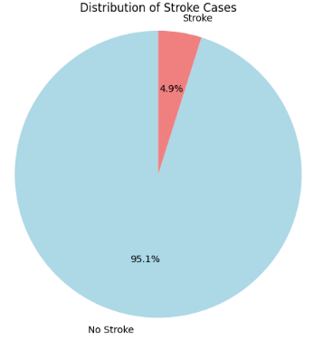
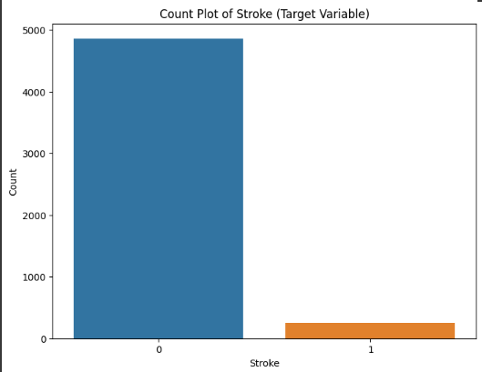
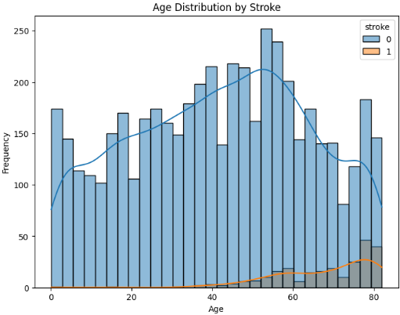

RESULTS
3/21/2024 Annual Review

